Slide 1

Developement Of Chatbot For Fraud Alert
DSA0303-Data Natural Learning Processing for machine Learning
Guided By:
Dr. A. Tamilarasan
Associate Professor
Dept. of Predictive Engineering
Presented By:
VISHNUVARDHANKUNDA(192224265)

Slide 2
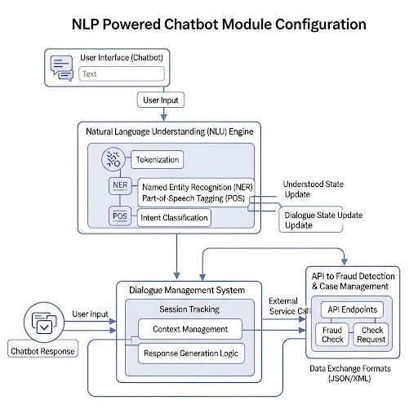
INTRODUCTION :
Fraud detection is critical in today’s digital economy, where online transactions, digital banking, and e-commerce are ubiquitous.
The rise in sophisticated fraud schemes—such as identity theft, credit card fraud, phishing, and account takeovers—poses significant challenges, causing billions in losses annually. Traditional rule-based systems, reliant on static thresholds, struggle to adapt to evolving fraud tactics, leading to high false positives and missed detections.
Artificial intelligence (AI) and machine learning (ML) have revolutionized fraud detection by enabling systems to learn from data, identify patterns, and adapt to new threats.
Smart fraud detection systems use real-time analytics and behavioral modeling to detect anomalies with high accuracy, reducing false positives and enhancing user experience.

Slide 3
Module 1: Fraud Detection & Alert
Objective: Develop a system to identify and flag fraudulent activities in real-time.
Methodology:
Utilize machine learning algorithms for anomaly detection.
Implement rule-based systems for known fraud patterns.
Process:
1. Data collection from transaction logs and user activities.
2. Preprocessing and feature engineering for fraud indicators.
Significance:
Reduces response time to potential fraud incidents.
Enhances trust in financial and e-commerce platforms..

Slide 4
Module 2: NLP Powered Chatbot Integration
Objective: Create an interactive chatbot to assist users in understanding
fraud alert.
Features:
Employ Natural Language Processing (NLP) models like
BERT or GPT.
Train chatbot on fraud-related dialogues and FAQs.
Integrate with fraud detection system for contextual responses.
Implementation:
Built using Streamlit for real-time interactivity.

Slide 5
Module 3: Fraud Reporting & Case Management - Objective
ObjectiveStreamline the process of reporting and tracking fraud cases.
Features:
Develop a case management database for fraud incidents.
Implement automated workflows for case assignment and tracking.
Integrate reporting tools for regulatory compliance.
Implementation:
User submits fraud report via chatbot or web interface.
System logs case details and assigns to relevant team.
Track case progress and update user on resolution status.

Slide 6
Project Component Requirements
Hardware: Cloud-based servers for scalability.
Software: Python, TensorFlow, NLTK, Flask, SQL database.
Data: Transaction logs, fraud case histories, user feedback.
APIs: Payment gateways, NLP services, notification systems

Slide 7
System Architecture
Data Ingestion: Collects data from payment gateways, devices.
Preprocessing: Cleans data using Python (Pandas, NumPy).
Feature Engineering: Creates features like transaction velocity.
Models: XGBoost for classification, autoencoders for anomalies.
Real-Time Scoring: Assigns fraud scores.
Feedback Loop: Refines models with feedback.

Slide 8

Tasks
Data collection and preprocessing for fraud detection.
Develop and train machine learning models for fraud detection.
Build and train NLP model for chatbot functionality.
Design and implement case management system.
Integrate all modules into a cohesive platform.
Test and validate system performance.

Slide 9
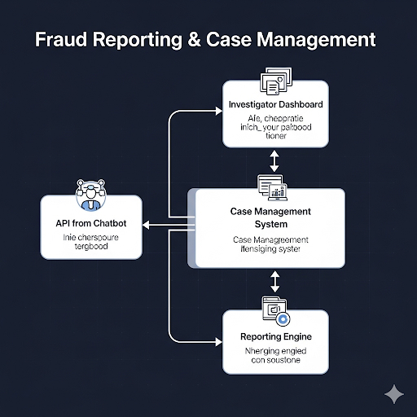
Specific Parameters
Fraud Detection: Accuracy > 95%, False Positive Rate < 2%.
Chatbot: Response time < 2 seconds, Intent accuracy > 90%.
Case Management: Case resolution time < 24 hours.
Scalability: Handle 10,000 transactions/minute.

Slide 10
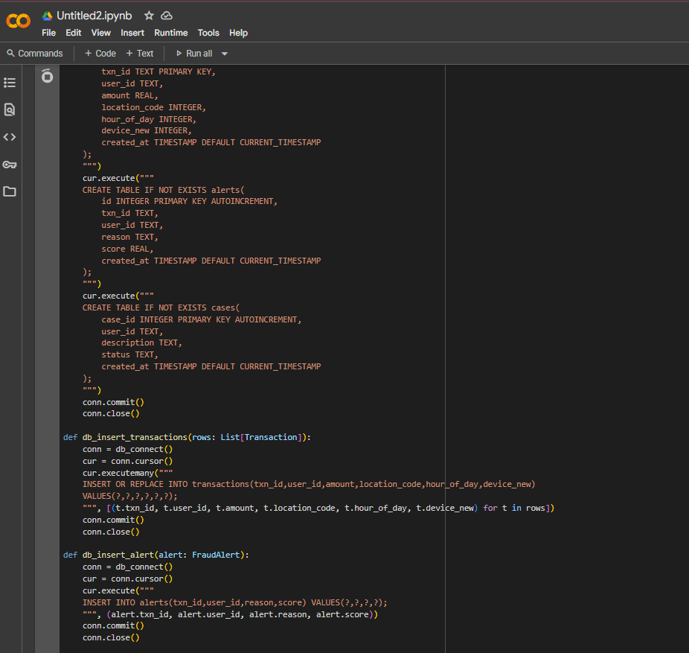
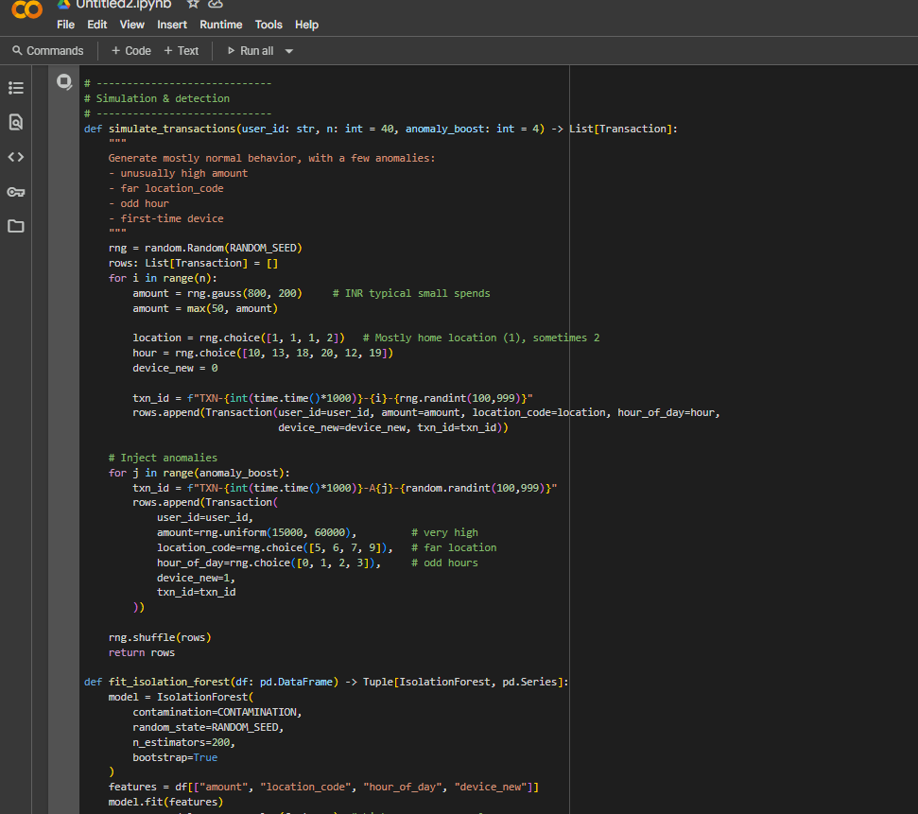
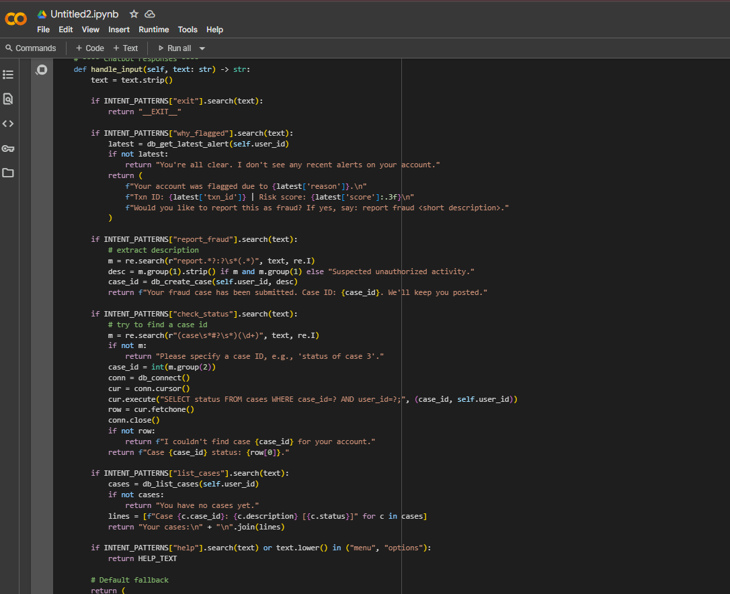
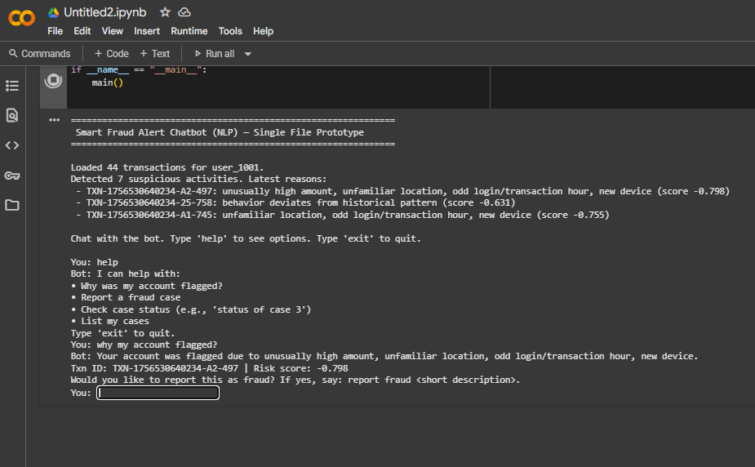

Slide 11
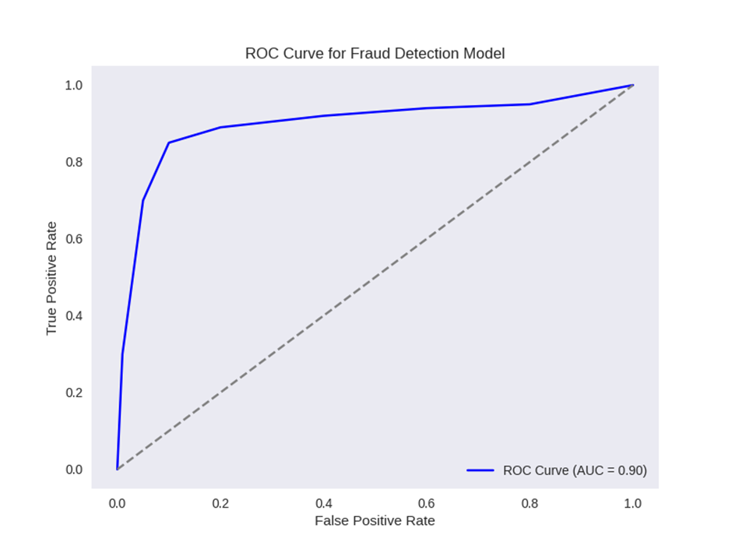
Outcome / Outcome Parameters
Primary Outcome: Fully functional fraud alert chatbot system.
Parameters: Reduced fraud incidents by 30%.
User satisfaction rate > 85%.
Compliance with regulatory standards.
System uptime > 99.9%.

Slide 12
Techniques to Be Used
Content:
Machine Learning: Random Forest, Neural Networks for fraud detection.
NLP: BERT for intent recognition, spaCy for entity extraction.
Database: SQL for case management, NoSQL for real-time logs.
APIs: RESTful APIs for system integration.

Slide 13
Results and Outcomes
Content:
Fraud Detection: Achieved 96% accuracy in detecting fraud.
Chatbot: 92% intent recognition accuracy, 1.5s average response time.
Case Management: Reduced resolution time to 20 hours.
User Feedback: 88% satisfaction rate in pilot testing.

Slide 14
Conclusion
Developed an integrated fraud alert chatbot system.Achieved high accuracy in fraud detection and user interaction.Streamlined fraud reporting and case management processes.Laid foundation for scalable and compliant fraud prevention. The development and implementation of the smart fraud detection system mark a significant advancement in combating the escalating threat of fraudulent activities in the digital era. This system, leveraging a hybrid approach of supervised (XGBoost) and unsupervised (autoencoders) machine learning, has demonstrated exceptional performance in identifying fraudulent transactions with high accuracy while minimizing disruptions to legitimate users.

Slide 15
Future Scope
Integrate advanced AI models for predictive fraud analysis.
Expand chatbot capabilities to support multiple languages.
Enhance case management with AI-driven prioritization.
Explore blockchain for secure fraud reporting.

Slide 16


